Slide 1

Weekly wages of US male workers in 1988
Bryan Butto
June 29, 2021

Slide 2
Agenda
Study Objective
Data Set
Data Diagnostics
Corrplot Results
Featureplot Results
Feature Selection Results
Modeling Results
Plotting the Results
Variable Importance Results
Plotmo Results
Study Conclusions

Slide 3
Study Objective
To predict the weekly wage of US male workers using wage data from 1988
Many factors can effect wage, including education, experience, race, and location
Objective
To build a predictive model that can predict the weekly wage of a US male worker using different factors
To determine which factors best predict wage and the relationship they have with wage

Slide 4

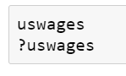
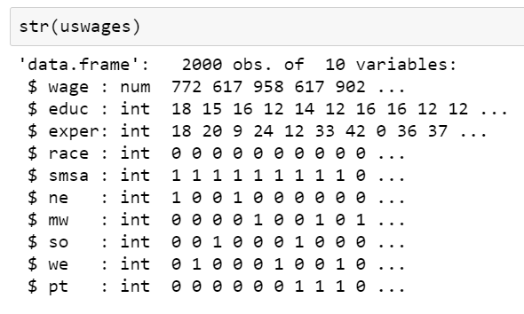
Data Set

Slide 5
Data Set
Dataset – uswages dataset from the faraway library in R
The dataset is composed of 2,000 observations of weekly wages for US male workers in 1988
Response variable – wage, which is the weekly wage in dollars
Predictor variables
educ – Years of education
exper – Years of experience
race – dummy variable (1 if Black, 0 if White)
smsa – Standard metropolitan statistical area, dummy variable (1 if living in Standard Metropolitan Statistical Area, 0 if not)
ne – Northeast, dummy variable (1 if living in the North East)
mw – Midwest, dummy variable (1 if living in the Midwest)
we – West, dummy variable (1 if living in the West)
so – South, dummy variable (1 if living in the South)
pt – Part time, dummy variable (1 if working part time, 0 if not)

Slide 6
Data Diagnostics
There are no missing values
There were some outliers for wage measured as +/- 3 standard deviations from the mean, however this was to be expected, since there will be individuals with very high wages.
This made the data right skewed.
The Pearson Test for normality indicated the data was not normally distributed, but as indicated above, the data is right skewed.
The log of the wage data was taken to determine if normality was improved, but it was still not normally distributed per the Person Test.
It was determine to not include the data transformation in the modeling process.
Overall, we conclude that the data set is not normally distributed but is clean.

Slide 7
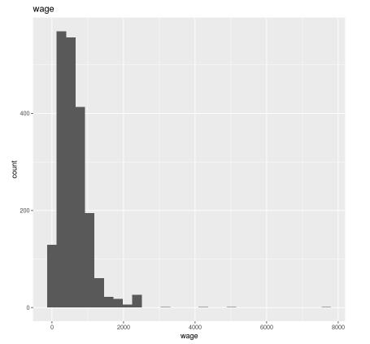
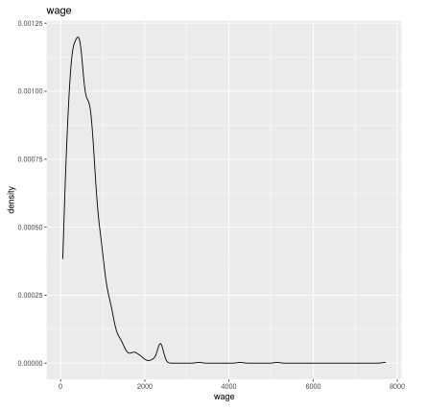
Data Diagnostics
Histogram and Density Plot of the response variable wage
Plots show wage in not normally distributed and skewed right

Slide 8
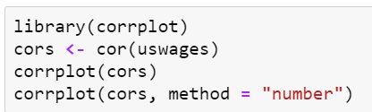
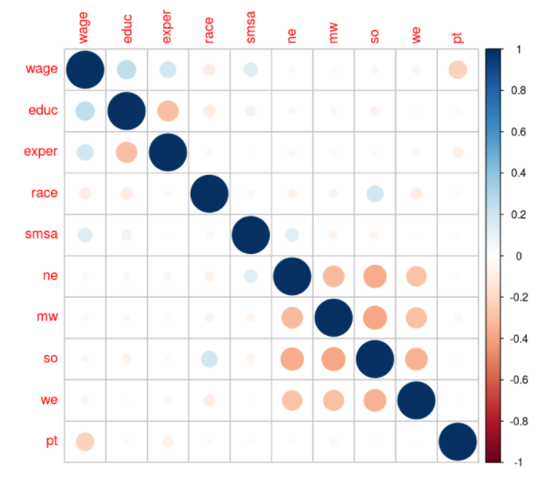
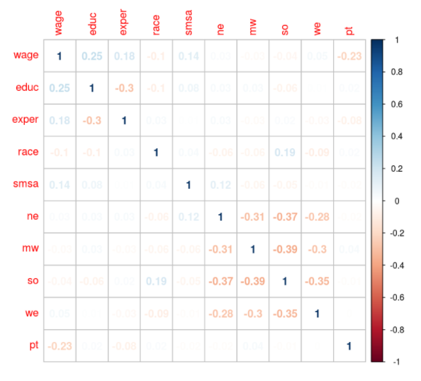
corrplot Results
There is a weak to moderate negative correlation between the location variables of ne, mw, so, and we.
The rest of the predictors are weakly correlated with each other.
The correlations between the response variable wage and the predictor variables are weak with the highest being educ at 0.25.

Slide 9
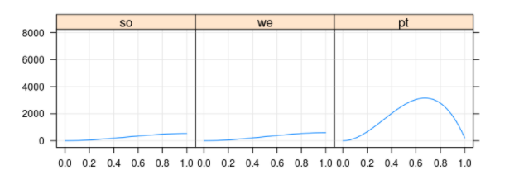
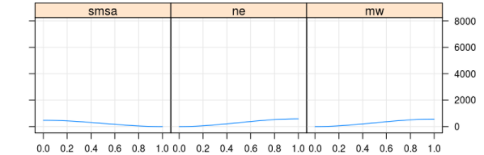
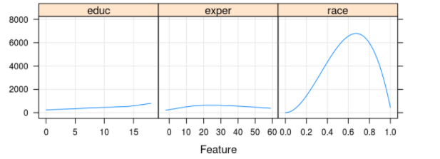
featurePlot Results
Significant Nonlinearities for Part time and Race with wage
Not as significant nonlinearites with South, West, Standard Metropolitan Statistical Area, North East, Midwest, Education, and Experience with wage
Linear models may not predict the best because of the nonlinearities.

Slide 10
Feature Selection Results
In the data diagnostics section, we determined that there were some nonlinearities between the response variable and some of the predictor variables.
We also determined that variable transformations were not going to be used in modeling.
The step function was used to determine which variables would be used in the modeling process
One of the location variables was removed from the model as they were dummy variables
The step function removed the we variable.
The data set was split 75% / 25% for training and testing purposes.
Visualizations were used to compare the training and testing data sets which means we will be able to make predictions from our models.

Slide 11
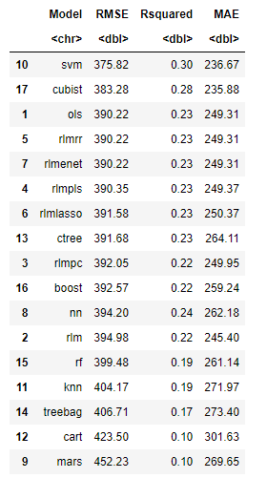
Modeling Results
17 different models were run.
Support Vector Machine and Cubist models performed the best. Had highest R2 value and lowest RMSE
R2 > 25%
RMSE < 385
Support Vector Machine model was best
Cart and MARS models performed the worst with the lowest R2 values and highest RMSE.
R2 = 10%
RMSE > 420

Slide 12
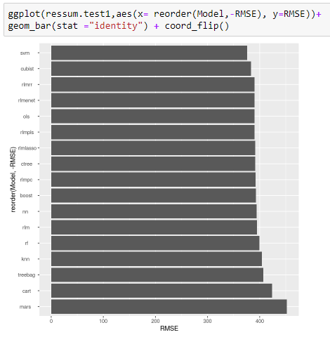
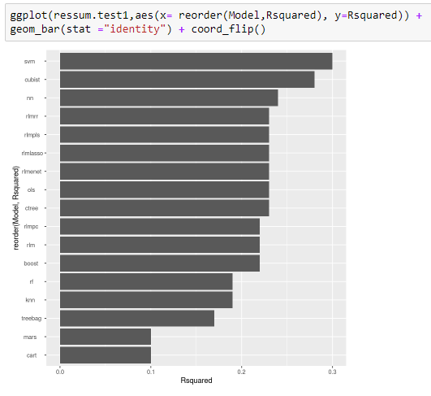
Plotting the Results

Slide 13
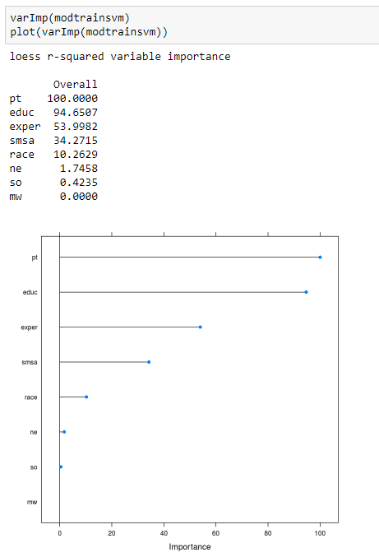
Variable Importance results
Part time is the most important factor in predicting wage.
Education is also a very important factor
Experience and Standard Metropolitan Statistical Area are next most important factors
Race is only a minimally important factor.
Northeast, South, and Midwest are not important factors when predicting wage

Slide 14
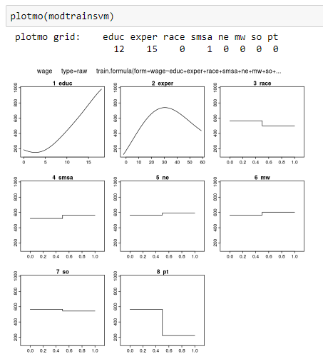
Plotmo results
Education and Experience and nonlinear predictors of wage
You can see the importance of Part Time and Education
Experience does have some importance
Standard Metropolitan Statistical Area and Race show minimal importance
Northeast, Midwest, and South have almost no importance

Slide 15
Study Conclusions
Models
Support Vector Machines which is a nonlinear modeling method had the best performance
Cubist model which is a tree based modeling method had the second best performance
Predictors
The best predictors of wage were Part time, Education, and Experience
Workers who worked Part time tended to have much lower wages than workers who worked full time.
Workers with more years of Education tended to have higher wages than workers with less years of Education
Workers with more years of Experience tended to have higher wages than workers with less years of Experience

Slide 16
Study Conclusions
Next steps
Improving models using expanded grid searches
Other variables outside of this study that may predict wage
Age
Performance reviews
Boss

